Slide 1
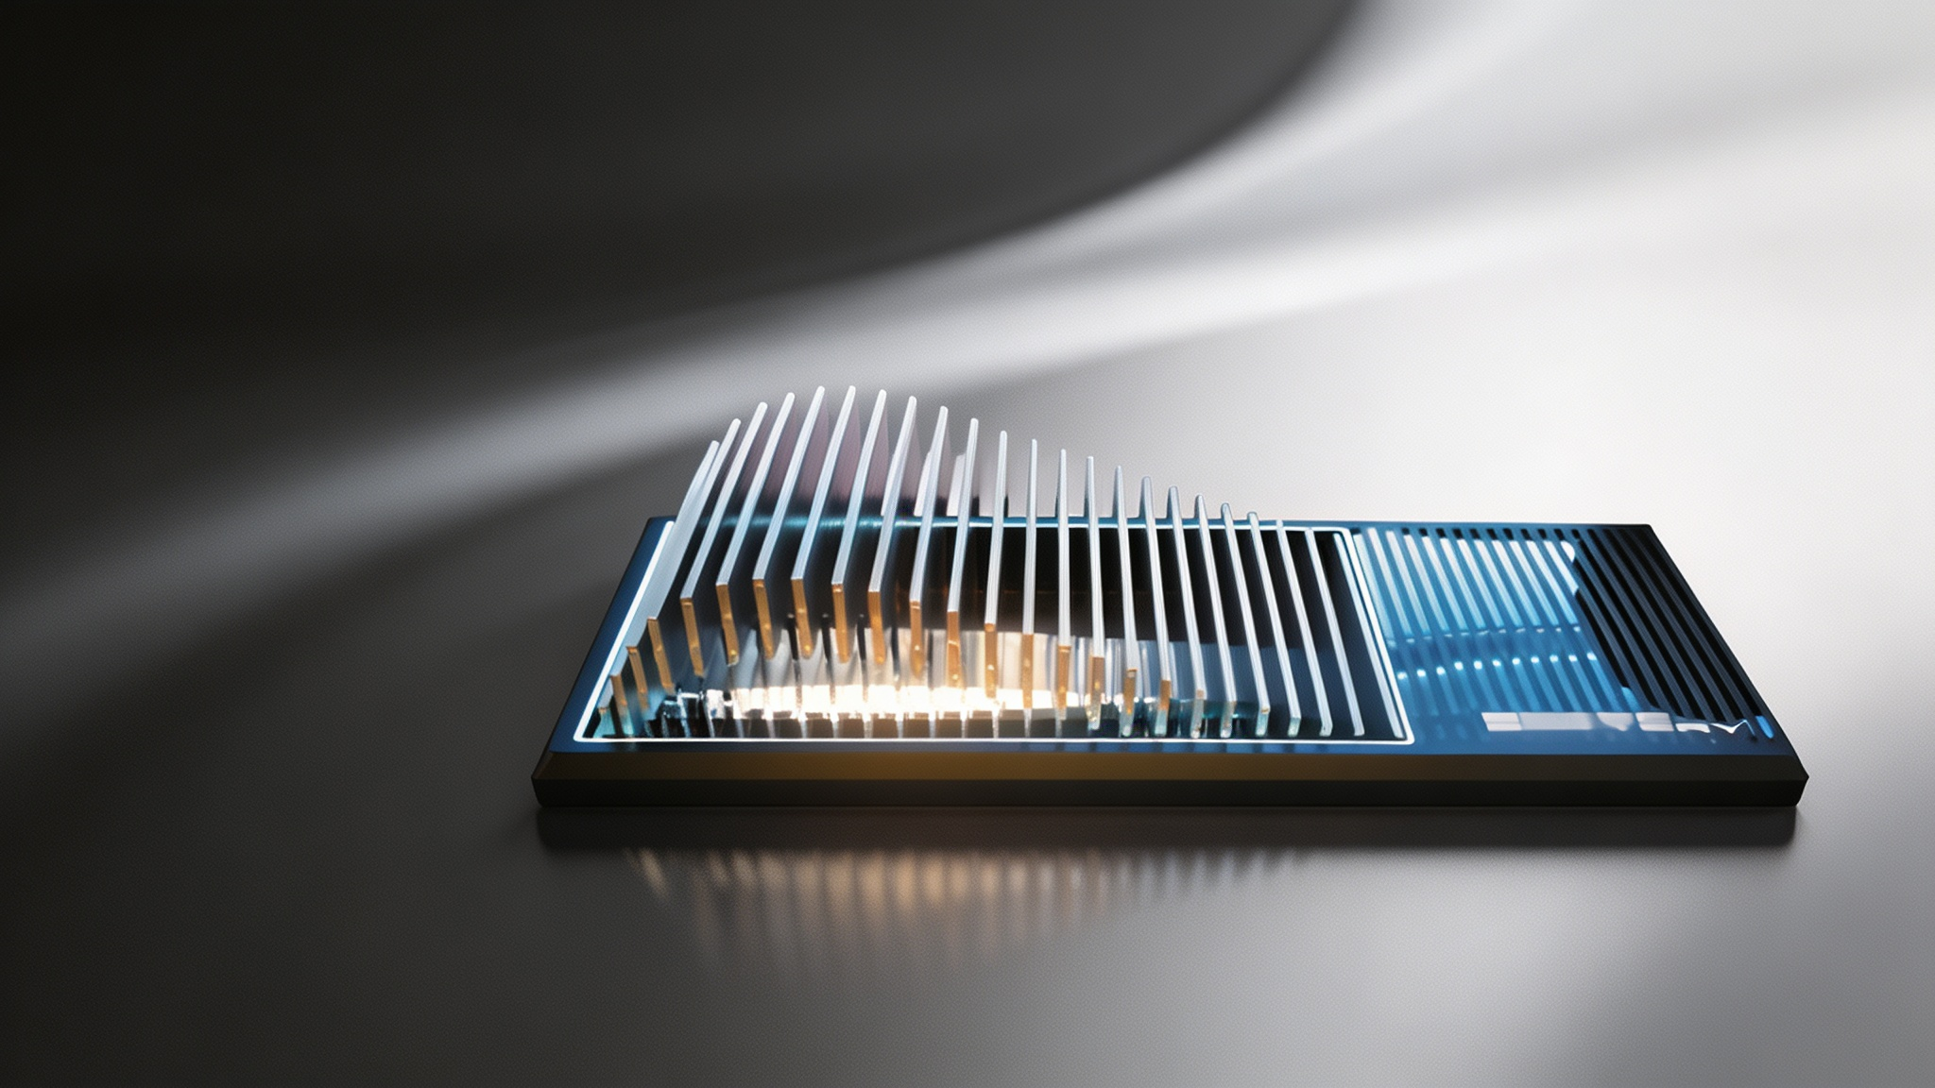
BYD Blade Battery:
Overcoming U.S. EV Battery Supply Chain Restrictions
BY
Tianhao Mo & Yuyang Wei
Notes:
Good morning/afternoon, everyone. Today, we will present our case study on BYD's Blade Battery, exploring how this innovative technology is helping China's EV industry overcome significant challenges posed by U.S. supply chain restrictions. Our presentation will analyze the technology, its development, and its strategic implications for technological self-reliance.

Slide 2

Table of Contents
01. Introduction: The Geopolitical Context of EV Batteries
05. Deep Analysis & Strategic Enlightenment
02. Technology Background & Chokehold Dilemma
06. Existing Shortcomings & Future Prospects
03. Independent R&D Process Roadmap
07. Conclusion & Key Takeaways
04. R&D Achievements & Application Effects
"Innovation is not just about technology, but about redefining the geopolitical and industrial rules of the game."
Notes:
Here is the outline of our presentation. We will start with an introduction to the geopolitical context, then delve into the technology and the challenges it addresses. We will trace BYD's R&D process, present its achievements, and offer an analysis. Finally, we will discuss the battery's shortcomings, future prospects, and conclude with our key findings.

Slide 3
Introduction - The Geopolitical Battlefield
The global race to electrify transportation has intensified, positioning battery technology and its complex supply chains at the very center of escalating U.S.-China geopolitical and economic tensions.
Key U.S. Policy Frontlines & Strategic Countermeasures
Strategic Threat Framing
Washington has formally categorized China's entire clean-energy industrial complex as a core "strategic threat" to national security interests.
Escalating Tariff Barriers
Implementation of quadrupled tariffs on Chinese EV imports and a baseline 25% duty on lithium-ion batteries set to take full effect in 2026.
IRA Supply Chain Exclusion Clauses
The Inflation Reduction Act contains strict provisions that effectively ban any EV containing Chinese battery components from accessing federal tax credits.
Military-linked Entity Designations
Industry leaders including BYD and CATL face designation as military-linked entities, signaling forthcoming investment and operational restrictions.
Central Research Question: How can China's EV industry strategically decouple and restructure to overcome these systemic supply-chain "chokeholds" imposed by U.S. industrial policy?
Notes:
The global shift to electric vehicles has turned battery technology into a major geopolitical battleground. The U.S. has responded with a series of policies, including tariffs, subsidy restrictions under the IRA, and entity designations, all aimed at restricting China's EV and battery industry. This raises a critical question: How can China navigate these supply chain "chokeholds"?

Slide 4
Introduction - The Blade Battery as a Solution
This presentation centers on BYD's Blade Battery, a domestically engineered Lithium Iron Phosphate (LFP) technology that represents a significant advancement in battery innovation and strategic resilience.
Unparalleled Inherent Safety
Extended Operational Lifespan
Deep Supply Chain Localization
Utilizing chemically stable LFP materials, the design fundamentally mitigates thermal runaway risks, setting a new benchmark for fire safety standards in the industry.
Delivering exceptional cycle durability far exceeding conventional alternatives, it significantly lowers the total cost of ownership for both consumer and commercial vehicle applications.
Predominantly relying on domestic raw material sourcing and indigenous manufacturing processes, it effectively insulates production from geopolitical and supply chain external pressures.
Presentation Roadmap & Analytical Framework
01. Tech & Bottlenecks Audit
Systematically review core cell-to-pack innovations and identify industry choke points.
02. R&D Evolution Chronicle
Trace BYD's iterative engineering journey and quantify real-world performance efficiency gains.
03. Geopolitical Comparative Lens
Benchmark against global competitors to extract strategic lessons for domestic industry autonomy.
04. Future Outlook Synthesis
Conclude with existing industrial hurdles and the roadmap for next-generation LFP applications.
Core Thesis: Homegrown innovations like the Blade Battery are critical strategic assets for reducing high-tech industry vulnerability in an era of global competition.
Notes:
Our focus is on BYD's Blade Battery, a domestically developed LFP technology. Its key advantages—high safety, long life, and localized production—position it as a potential solution. In this presentation, we will argue that such domestic innovation is crucial for reducing China's vulnerability to external sanctions.

Slide 5
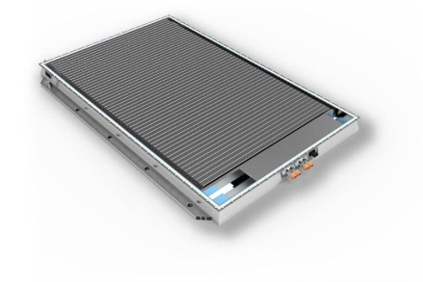
Technology Background - What is the Blade Battery?
1. Chemistry: Lithium Iron Phosphate (LFP)
Utilizes abundant Iron (Fe) and Phosphate materials, eliminating reliance on scarce Nickel (Ni) or Cobalt (Co). This formulation delivers exceptional inherent safety, a prolonged cycle life, and significant cost advantages, despite its historically lower energy density profile.
2. Design: The Revolutionary "Blade" Architecture
Redefines structural integration through thousands of long, flat "blade" cells replacing conventional prismatic formats. Cells are organized in a honeycomb steel matrix, directly integrating into the pack frame via the innovative Cell-to-Body (CTB) technology for supreme space efficiency.
Structural Innovation Visualized
The modular unit demonstrates the ultra-thin cell arrangement that maximizes volumetric efficiency within the battery pack enclosure.
Notes:
So, what exactly is the Blade Battery? It's based on Lithium Iron Phosphate, or LFP, chemistry. This means it uses abundant materials like iron and phosphate, avoiding costly and geopolitically sensitive metals like nickel and cobalt. The key innovation is its "blade" architecture, which uses long, flat cells arranged in a honeycomb structure, integrating them directly into the battery pack frame.

Slide 6
Technology Background - Advantages of the Blade Design
01. Unmatched Space Efficiency
02. Cell-to-Body Structural Safety
03. Geopolitical & Material Resilience
By eliminating intermediate module supports, the innovative structural architecture unlocks significant internal space within the pack.
The result is a claimed~50% reduction in pack volumecompared to conventional LFP configurations, drastically improving overall volumetric efficiency.
Integrating cells directly into the body increases rigidity. Its elongated form factor provides superior surface-to-volume ratio for consistent thermal management.
In stringent nail-penetration tests, the Blade Battery showsno thermal runaway (surface < 60°C), a stark contrast to NMC batteries which typically ignite violently.
Utilizing Lithium Iron Phosphate (LFP) chemistry inherently avoids reliance on volatile Nickel and Cobalt markets, insulating costs from global supply shocks.
With China controlling nearly100% of global LFP production capacity, the design ensures a highly resilient and domestically secure supply chain ecosystem.
Notes:
The Blade design offers three key advantages. First, its space efficiency is dramatically improved, with a 50% reduction in pack volume. Second, it's significantly safer, passing extreme tests like nail penetration without catching fire. Finally, because it uses LFP chemistry, it achieves a high degree of supply chain independence, free from the vulnerabilities associated with nickel and cobalt.

Slide 7
The "Chokehold" Dilemma - U.S. Sanctions & Supply Chain Pressures
The U.S. strategy aims to isolate China's battery technology through multi-dimensional containment, triggering a series of strategic countermeasures in critical industrial sectors.
1. Materials & Critical Minerals
2. High-End Equipment & Core Patents
3. Market Access & Policy Barriers
Containment Target:Restrict access to advanced processing technology for core resources including Lithium (Li), Nickel (Ni), and Cobalt (Co).
Strategic Counter:Accelerate full industrial chain self-sufficiency, particularly leveraging advantages in domestic LFP (Iron & Phosphate) material reserves.
Containment Target:Implement strict export controls to block the sale of cutting-edge manufacturing equipment and limit Chinese entities' access to Western technical blueprints.
Strategic Counter:Foster indigenous innovation; BYD has independently developed "over 300 core patents" supporting the domestic Blade Battery ecosystem.
Containment Target:Levying punitive tariffs and utilizing the Inflation Reduction Act (IRA) to systematically exclude Chinese components from U.S. green industry tax incentives.
Strategic Counter:Diversify trade routes by deepening economic ties with Europe and ASEAN nations while consolidating the vast domestic consumer market demand.
Notes:
The U.S. strategy to contain China's battery industry works on three fronts: restricting access to materials, blocking high-tech equipment and patents, and creating market barriers through tariffs and policy. However, China's response, exemplified by the Blade Battery, is to leverage its self-sufficiency in LFP materials, develop domestic patents, and diversify its export markets.

Slide 8
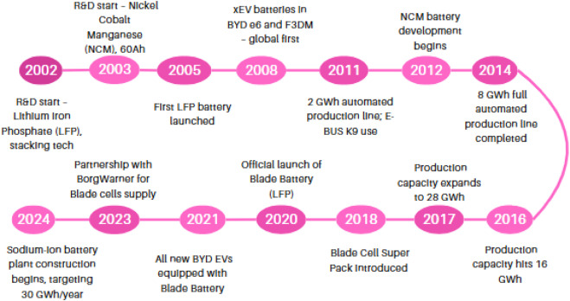
Independent R&D Process - A Timeline of Innovation
BYD's journey to the revolutionary Blade Battery was not an overnight success, but a result of decades of cumulative research, technological breakthroughs, and forward-thinking strategic planning in the energy storage sector.
2002: Foundational Research Initiation
Official R&D commences focusing on Lithium Iron Phosphate (LFP) core stacking technology architecture.
2021: Full Ecosystem Integration
Blade cells become the standard configuration across BYD's entire new energy vehicle product lineup.
2008: Commercialization Breakthrough
The first generation of mass-produced LFP batteries is successfully launched, validating core technical routes.
2023: Global Supply Chain Expansion
Strategic partnership established with BorgWarner to supply Blade cells, accelerating global industrialization influence.
2019-2020: The Blade Battery Era Dawns
Chongqing pilot lines established; the revolutionary Blade Battery is officially launched, redefining safety standards.
2024: Next-Gen Energy Diversification
Construction of Sodium-ion battery plant begins, building a solid technical backup for future low-cost energy storage.
Historical Research and Development Roadmap Overview Chart:
Notes:
The development of the Blade Battery wasn't an overnight success. As this timeline shows, BYD's journey began in 2002 with early LFP research. After years of development, the first LFP battery was launched in 2008, leading up to the official unveiling of the Blade Battery in 2020. This long-term commitment to R&D was crucial.

Slide 9
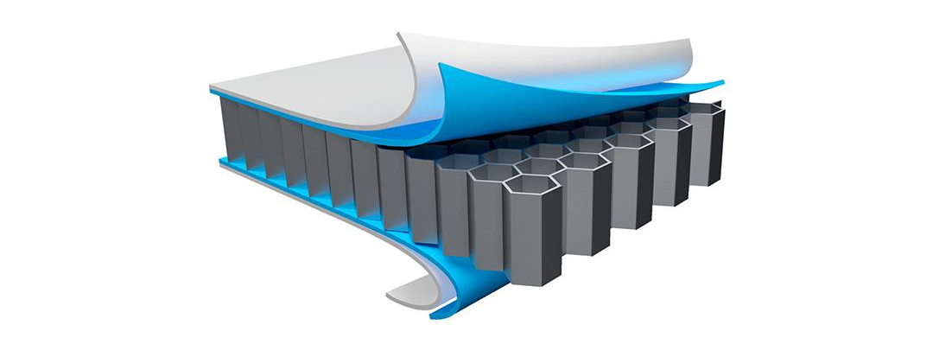
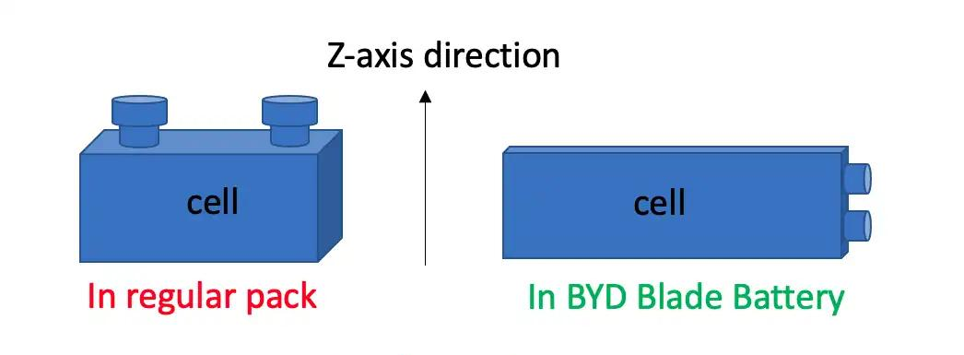
R&D Process - Overcoming Technical Challenges
01. Identifying Core Technological Limitations
The R&D team pinpointed critical bottlenecks in conventional LFP cells, including excessive physical footprint and thermal runaway . The primary strategic goal was set to radically elevate volumetric packaging efficiency and extend the cycle life significantly through structural re-engineering.
Fig 1. Structural decomposition of the novel blade cell array architecture.
02. Systematic Prototype Engineering & Integration
A paradigm shift was achieved by conceptualizing cells as structural beams, evolving into the innovative long-form "Blade" design. This necessitated full production line retooling for high-precision assembly. Furthermore, the revolutionary "Cell-to-Body" concept was developed, directly embedding battery arrays into the vehicle's steel frame to optimize space utilization.
Fig 2. Comparative schematic of volumetric efficiency in traditional vs. blade pack configurations.
Notes:
To overcome the limitations of traditional LFP batteries, BYD's engineers had to innovate. They identified the need to increase packaging efficiency. This led to the novel "blade" cell shape, which acts as a structural beam, and the "Cell-to-Body" integration concept. These innovations required significant re-engineering of manufacturing processes.

Slide 10
R&D Achievements - Technical Superiority
1. Safety & Reliability Enhancement
2. Energy Density & Extended Range
Empirical proof shows no flame under severe abuse, maintaining surface temp <60°C vs >500°C for NMC batteries. This implies easier certification and a strong marketing advantage.
High space efficiency enables ~570 km CLTC range for the BYD Seal. Blade 2.0 (LMFP) elevates density to 190-210 Wh/kg, pushing flagship models beyond the 1,000 km milestone.
3. Exceptional Long Cycle Lifespan
4. Unmatched Production Cost Efficiency
Engineering longevity is proven by retaining >70% capacity after 1.2 million km or over 5,000 deep cycles. This durability drastically lowers the total cost of ownership for end-users.
Eliminating cobalt and nickel raw materials saves hundreds per pack. Analysts estimate Blade packs achieve a20-30% cost advantage per kWhcompared to conventional NMC alternatives.
Notes:
The Blade Battery's technical superiority is evident across several metrics. It is dramatically safer, with surface temperatures remaining below 60°C during abuse tests. While LFP has lower energy density, the Blade's design closes the range gap, and future versions promise even more. Its exceptional cycle life drastically lowers the total cost of ownership, and its cost structure is estimated to be 20-30% cheaper than competing NMC batteries.

Slide 11
Analysis - Comparative Analysis with Foreign Technologies
A comprehensive head-to-head evaluation between BYD's innovative Blade Battery (LFP) and the conventional high-nickel NMC cells prevalent in Western markets.
Key Parameter | BYD Blade Battery (LFP) | Conventional NMC Battery | Strategic Trade-off Analysis
Energy Density | ~150-210 Wh/kg | ~250-300 Wh/kg | Blade intentionally sacrifices raw peak density to prioritize structural and chemical stability in daily cycles.
Cycle Lifespan | Exceeds 5,000 cycles | Approx. 1,000-2,000 cycles | Offers vastly superior longevity, reducing total ownership cost and enhancing second-life usability significantly.
Core Safety Profile | No fire/smoke; < 60°C thermal runaway | High fire/explosion risk; >200°C critical temp | Dramatically safer under extreme conditions like puncture or overcharging, minimizing liability risks.
BOM & Scaling Cost | ~20-30% lower at scale | Higher costs driven by Nickel/Cobalt pricing | Eliminates reliance on expensive conflict minerals, providing a decisive cost advantage for mass-market adoption.
Global Strategic Implications:The proven success of the Blade Battery architecture is fundamentally reshaping global supply chains, accelerating the adoption of LFP chemistry even in Western markets focused on budget resilience and passenger safety.
Notes:
When compared to conventional NMC batteries, the Blade Battery presents a clear trade-off. It sacrifices peak energy density for vastly superior longevity, safety, cost efficiency, and supply chain resilience. This pragmatic approach has proven successful and is accelerating the global adoption of LFP technology, even in Western markets.

Slide 12
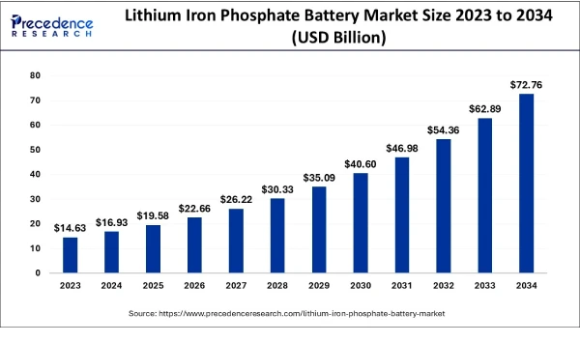
R&D Achievements - Market Impact
1. Market Share Expansion & Industry Paradigm Shift
In 2025, BYD's power battery installations in China hit approximately 165.8 GWh, empowering around 3.82 million electric vehicles and securing a 21.6% market share. This dominance has catalyzed a profound industry-wide transition towards LFP chemistry.
2. Unmatched Safety Reputation and Consumer Confidence
Amidst growing consumer concerns over EV battery fires, BYD's strategic "safe battery" marketing narrative has strongly resonated. The Blade Battery maintains a pristine track record with no widely reported fire incidents or safety-related recalls, building enduring trust.
LFP Market Trajectory Outlook
The following chart illustrates the projected exponential growth of the Lithium Iron Phosphate (LFP) battery market from 2023 to 2034. This upward trend underscores the long-term commercial viability and technological advantages that BYD and other pioneers have unlocked within the energy storage sector.
Notes:
The Blade Battery's technical success has translated into significant market impact. BYD's battery installations in China reached nearly 166 GWh in 2025, capturing over 21% of the market. More broadly, its success has accelerated the industry's shift towards LFP chemistry, as shown in this market growth projection. Consumers have also responded positively to its strong safety reputation and track record.

Slide 13
Analysis - Strategic Lessons for Technological Development
The Blade Battery case offers four key strategic lessons for navigating global technological sanctions and fostering long-term industry resilience.
Domestic Innovation Pays Off
Heavy investment in in-house R&D, rather than licensing foreign tech, leads to greater technological autonomy. Sanctions pressure can be a powerful motivator for self-reliance.
2. Supply Chain Localization is Critical
Prioritizing the development of upstream industries (materials, equipment) creates a robust, self-contained ecosystem that is resilient to foreign export controls.
3. Strategic Flexibility is Key
Choosing a technology path (LFP) that best suits domestic resources and strategic goals (safety, cost) is more effective than a one-size-fits-all approach. Diversifying into alternatives like sodium-ion is also prudent.
4. Batteries are Geopolitical Tools
The technology and supply-chain choices have significant geopolitical weight. Controlling a key technology like LFP becomes a form of strategic leverage.

Slide 14
Existing Shortcomings of the Blade Battery
Despite its market successes and technological innovations, the Blade Battery still faces several non-negligible technical and market challenges that limit its full potential expansion.
1. Energy Density Ceiling Bottleneck
2. Diminished Low-Temperature Performance
Even with structural improvements, LFP-based cells likely max out around ~200 Wh/kg, inherently lower than leading NMC batteries, which limits its penetration in the high-end luxury EV segment.
The fundamental chemical properties of LFP result in significantly reduced conductivity in cold climates, directly leading to noticeable driving range attenuation during winter usage scenarios for end-users.
3. Persistent Critical Raw Material Reliance
4. Eroding First-Mover Advantage
While eliminating cobalt supply risks, the supply chain still heavily depends on imported lithium and graphite. Global geopolitical tensions and lithium price volatility continue to pose upstream production risks.
Competitors including CATL, CALB, and Gotion are rapidly advancing their LFP technologies with similar structural innovations. This intensifying homogenized competition is gradually compressing BYD's unique market moat.
Notes:
Of course, the Blade Battery is not without its shortcomings. It has an energy density ceiling compared to NMC batteries, which limits its use in high-end vehicles. It also suffers from weaker cold-weather performance. Furthermore, while independent of cobalt, it still relies on imported lithium and graphite. Finally, competition from other LFP battery makers is intensifying.

Slide 15
Future Prospects
01. Technical Advancements Roadmap
02. Long-Term Geopolitical & Market Strategy
Blade 2.0 & LMFP Integration
Focusing on the widespread adoption of manganese-enhanced LFP chemistry to significantly boost battery energy density and extend driving range capabilities.
Deepening Supply Chain Self-Sufficiency
Strategic further vertical integration of the industry ecosystem, exploring state-backed joint ventures to establish localized overseas battery manufacturing gigafactories.
Ultra-Fast "FLASH Charging" Revolution
Introduction of a high-capacity charging protocol supporting up to 1,500 kW, drastically reducing charging time and elevating the user convenience experience.
Navigating the Evolving Geopolitical Landscape
Proactive monitoring of policy shifts among U.S. allies regarding LFP technology adoption and preparedness for potential emerging trade frictions in the EV sector.
Frontier Material Science Research
Continuous investment in next-gen solid-state electrolyte development and advanced silicon doping techniques to push the boundaries of current performance limits.
Elevating Core Competitive Assets
Positioning the Blade Battery platform as a critical strategic asset in an era of tightening global trade barriers, ensuring long-term technological leverage and industry security.
Notes:
Looking to the future, BYD is working on technical advancements like Blade 2.0 with LMFP chemistry and ultra-fast charging. Strategically, the goal is to deepen self-sufficiency, possibly through overseas factories. As geopolitical tensions evolve, the Blade Battery and its successors will only grow in strategic importance for China's EV industry.

Slide 16
Conclusion
The Blade Battery is not merely a technological innovation, but a landmark achievement in China's strategic move toward full independence in the global electric vehicle supply chain.
Critical Strategic Takeaways Analysis
Blunting External Sanctions
Breaking Supply Monopolies
Path to Technological Autarky
The case underscores a broader lesson: technological autarky, achieved through vertical integration and local R&D, can turn sanctions into motivation for self-reliance.
Concentrated domestic innovation in LFP materials has created a globally competitive product ecosystem, successfully mitigating the impact of U.S. tech blockades and reducing foreign dependency.
The project exemplifies how to "break the chain" of supply-side restrictions. By substituting critical foreign components with high-quality homegrown alternatives, it ensures industrial security and resilience.

